Slide 1
Portfolio
Student portfolio

Slide 2
About me
Name:k.Abinaya
Department:BSC(computre science)
Academic Year:2024-2027
college name: valliammai Women’s College of arts and science
Percentage: 80%
Email ID: abinayakumar603@gmail.com
Phone no:7845637280

Slide 3
Type of table content
Myself
Academic information
Skills
Soft skills
Achievement
Personal detail
Conclusion

Slide 4
Myself
My name is”Abinaya” , second second year BSc (computer science) student with a passion for programming problem solving and whipped development I below in contribute to be industry bike create efficient and user friendly software application .

Slide 5
Academic information
Government higher secondary School (2022-2024)
SSLC in Passed 65%
HSLC in passed 75%
Steady now:
Valliammai Women’s College of arts and science (2024-2027)
BSC (COMPUTER SCIENCE)

Slide 6
Skills
Programming language
Python
C++
HTML

Slide 7
Soft skills
Presentation and communication
problem solving
Time management

Slide 8
Achievement
I am Semester exam in above in 90%
I achievement in government job

Slide 9
Personal detail
Date of birth: 01.06.2007
Language known: Tamil, English
Hobbies : writing, cooking ,sleeping ,drawing

Slide 10
Conclusion
I am enthusiastic learn with strong technological and communication skill I am configured that my skill project and declaration may help and achieve my goal

Slide 11
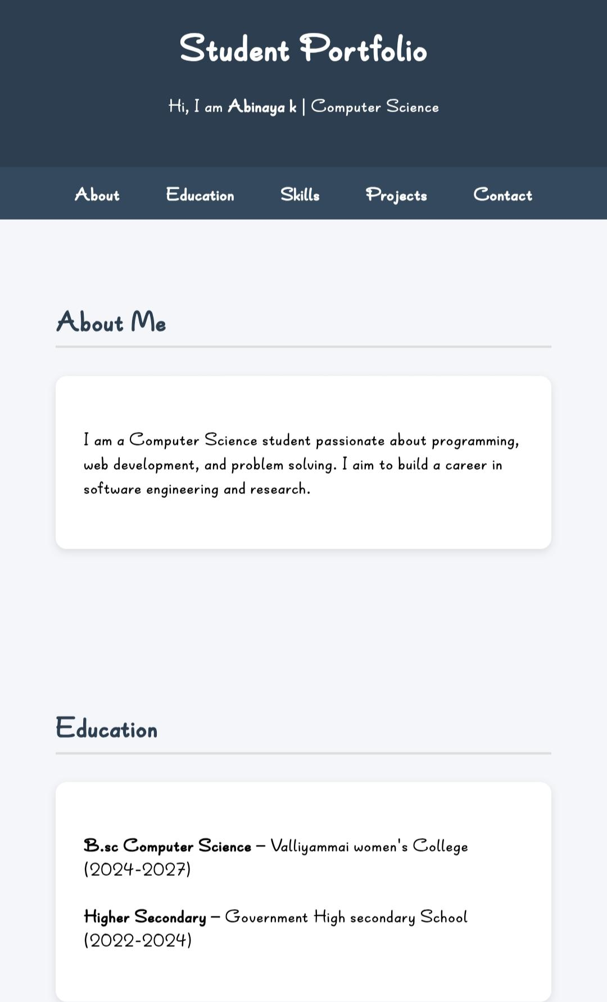
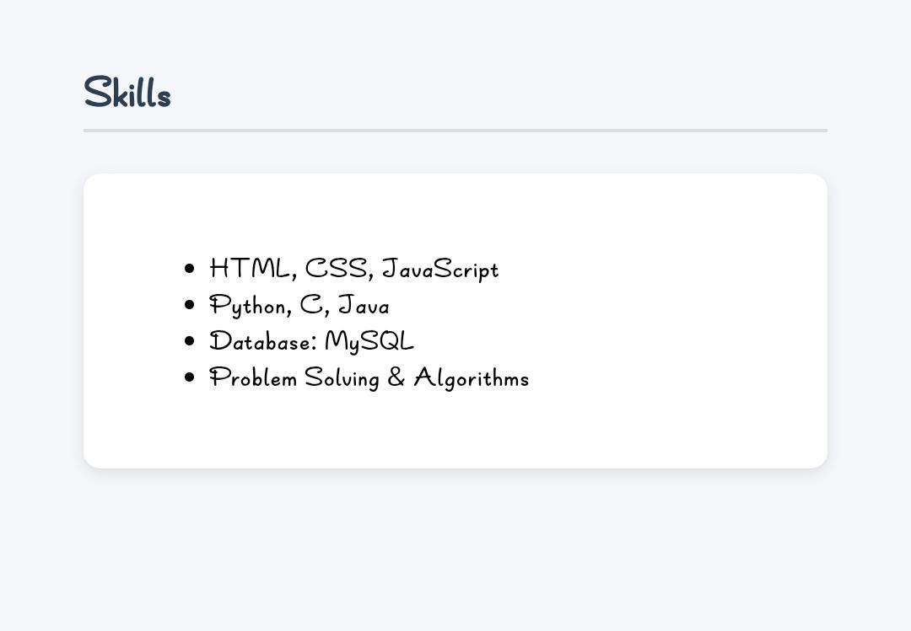
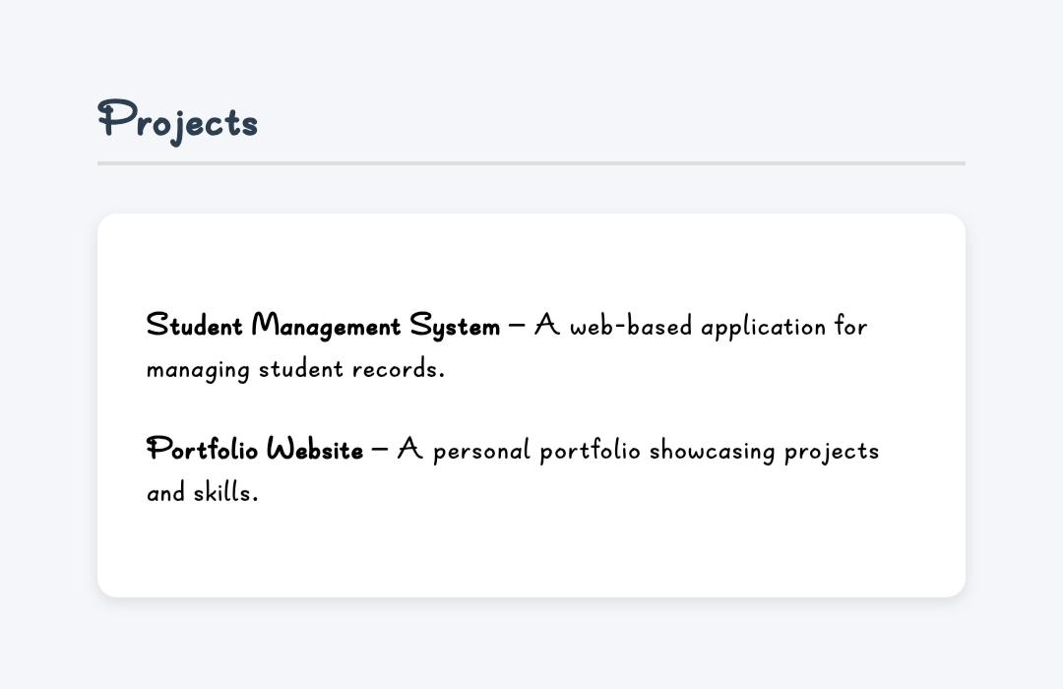
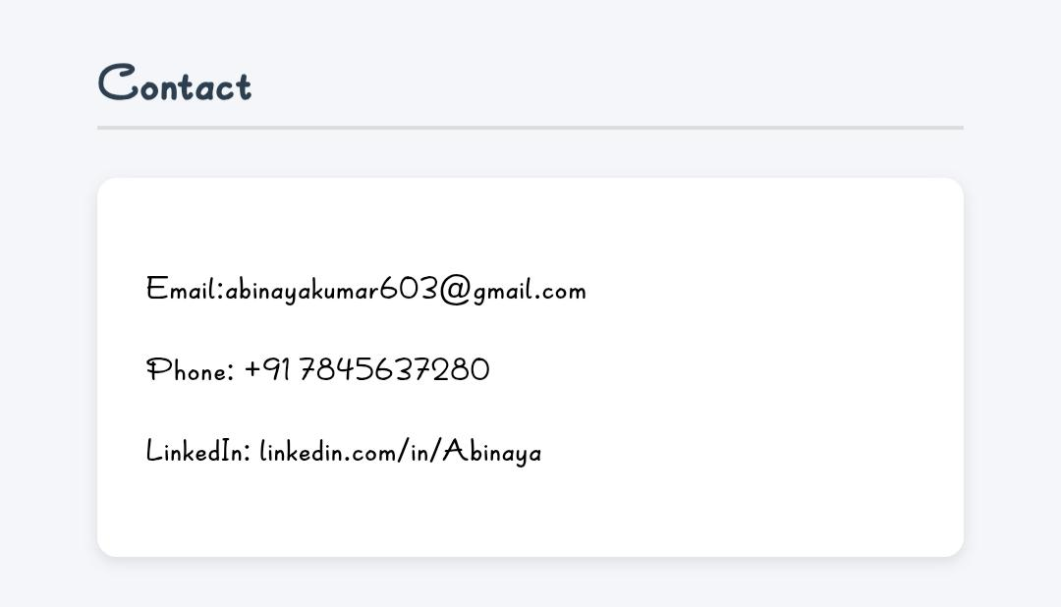

Slide 12
THE END
THANK YOU

